Slide 1
EagleCAD Tutorial
Andy Li
McMaster Solar Car Project

Slide 2

What is Eagle?
Stands for Easily Applicable Graphical Layout Editor
Draw out circuit schematics
Design circuit boards
Routing a good board takes patience and practice

Slide 3
Project examples

Slide 4
Terminology
Routes connect the circuit together (wires)
Pads are what the parts are soldered to
Default route thickness is 0.016in, good enough for most connections
Use thicker routes for high voltage/current
PCBs sometimes have more than one layer, use vias when routing to connect multiple layers

Slide 5
Terminology (cont.)
Ratsnest is a function that cleans up connections on the board
Ground plane represents ground, traces are cut out of the ground plane
Surface mount vs through hole packages
Eagle recognises a LOT of different components, organized by libraries
Finished PCBs are either milled out of copper board, or made professionally

Slide 6
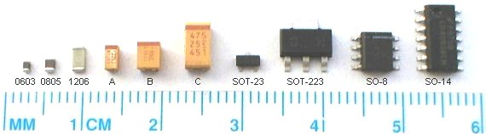
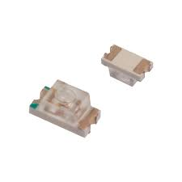
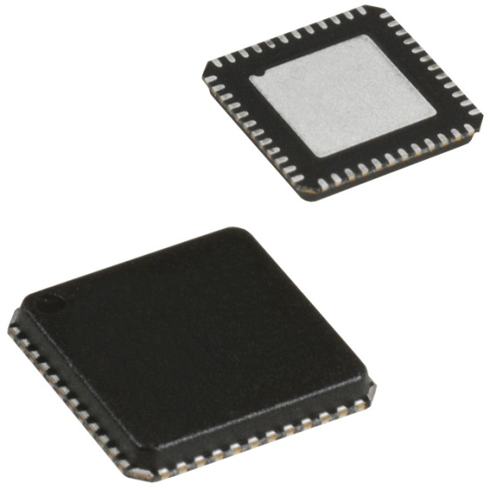
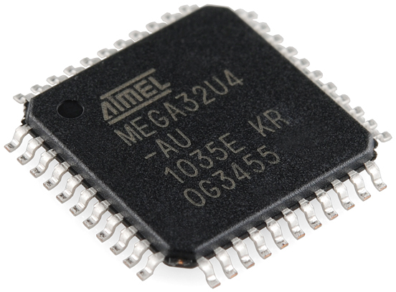
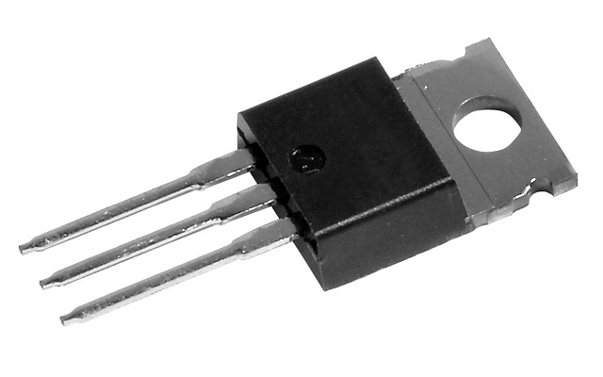
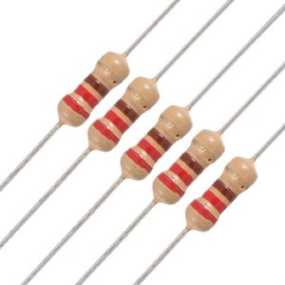
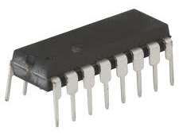

Slide 7
Designing a circuit
Start with the largest component in the circuit (microcontroller, chip, etc)
Arrange components into groups (power supply, filters, serial interface, etc)
Keep the schematic as tidy as possible, spread your components out a little, avoid cluttering wires
Label important nodes (supply, ground, output, I2C/SPI lines, etc)

Slide 8
Routing a board
Start with the largest component in the circuit
Place components where there would be the least overlap
Once everything is arranged neatly, create a ground plane, and start routing the board group by group, beginning with the closest components
Take into account spacing between routes and components

Slide 9
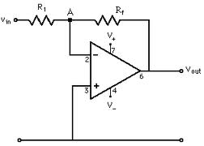
Example: Op-Amp Circuit

Slide 10
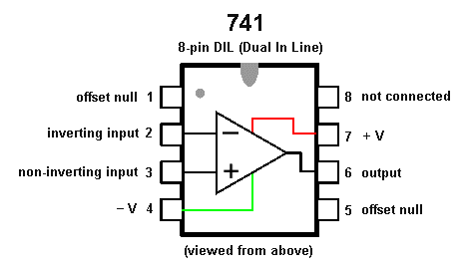

Slide 11
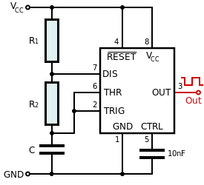
Exercise: 555 Timer circuit

